Slide 1

ITC6125A1 – Machine Learning & Applications
Face Mask Detector
Alkiviadis Kariotis 241735
Konstantinos Margaritis 122451
Prof.: Dr. Dimitrios Milioris

Slide 2
Presentation Overview
Introduction to Mask Detection - Theory & Techniques
CNN for Mask Detection
Real-time Mask Detection & Future improvements
CNN for Face Detection

Slide 3
Theory & Techniques
Overview of Convolutional Neural Networks (CNNs)
Basic components of CNNs and their roles
Understanding overfitting in deep learning
Techniques to detect and prevent overfitting
Explanation of Image Data Augmentation
Techniques used in Image Data Augmentation
Benefits of Image Data Augmentation

Slide 4
Overview of Convolutional Neural Networks (CNNs)
CNNs are commonly used for computer vision and classification tasks.
They are a class of neural networks that perform well when it comes to process pixel data.
CNNs can be a hierarchical structure where one convolutional layer follows another, enabling subsequent layers to capture more complex features.
They are considered more efficient for tasks that utilize speech, audio signals, and images.

Slide 5
Basic components of CNNs and their roles
Convolutional Layer
The core part of a CNN where most computation occurs.
Consists of specific parts like input data, a filter, and a feature map.
Helps to identify the basic features like edges in an image.
Pooling Layer
Responsible for reducing the spatial dimensions of the input.
Utilizes an aggregation function from the kernel to the values within the receptive field.
Two types: Average and Max Pooling.
Max Pooling: Extracts the most significant information in terms of amplitude. Helps in reducing overfitting and computational cost.
Average Pooling: Takes the average value within the receptive field, providing smoother image features.

Slide 6
Basic components of CNNs and their roles
Fully Connected (Dense) Layer
Every node in this layer is connected to a node in the previous layer.
Performs the task of classification using the features extracted in previous layers.
Typically uses the softmax activation function for classifying inputs based on probabilities ranging from 0 to 1.
Can capture associations between pairs of features in data points due to the dense interconnections.
Dropout
A regularization technique to reduce overfitting.
Achieved by randomly dropping weights within a certain probability to prevent over-reliance on specific features, promoting more robust learning.
Can be used between any layers.
Flatten Layer
Converts multi-dimensional layer output into a linear format to be fed into a dense layer.
Similar to the Dense layer in the sense that they do not possess weights and primarily serve to transform multidimensional data.
Commonly used before feeding the data into a Multilayer Perceptron (MLP) for classification tasks.

Slide 7
Understanding Overfitting in Deep Learning
Overfitting occurs when the model is overly tailored to the training data (Ying, 2019).
It happens when the model captures noise or irrelevant patterns, instead of learning generalized underlying patterns.
Overfitted models tend to underperform when tested on new and unseen data.
Overfitting can be detected using model evaluation techniques like K-fold cross validation.

Slide 8
Techniques to Prevent Overfitting
Early Stopping
Stops the training process before the model becomes over-specialized to the training data.
Helps in preventing overfitting by preserving the model's ability to generalize (Ying, 2019).
Feature Selection or Pruning
Involves eliminating irrelevant features.
Aids in preventing overfitting by reducing the model's complexity.
Regularization Techniques
Used to reduce the influence of irrelevant features.
These methods impose a penalty on the complexity of the model, encouraging the model to be simpler.
Data Augmentation
Introduces variations in the training data.
Helps in preventing over-reliance on specific patterns, thereby making the model more robust to new and unseen data (Amazon Web Services, n.d.).

Slide 9
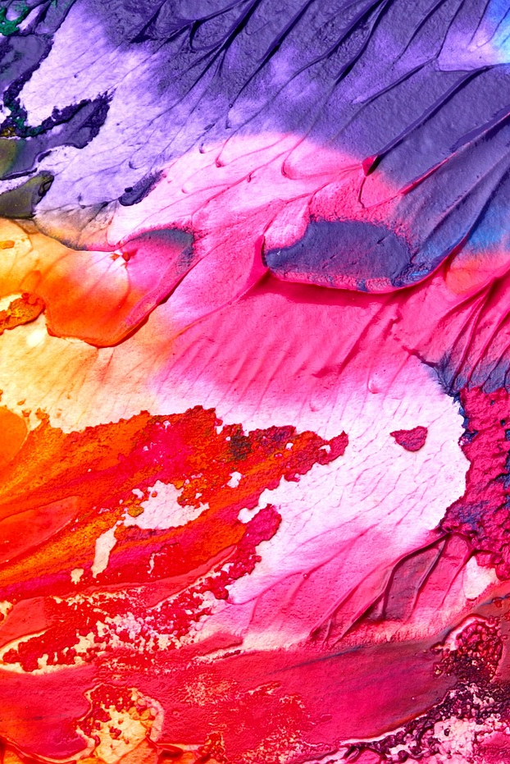
Image Data Augmentation
A technique used to create varied image in an existing dataset for improving computer vision tasks
Benefits of Image Data Augmentation
Introduces diversity, mitigates overfitting, increases the effective dataset size, and enhances model robustness.
Techniques used in Image Data Augmentation
Position Manipulation: Involves altering image position using scaling, rotation, or flipping.
Color Manipulations: Adjusts image contrast, brightness, hue, and saturation.
Cropping, Blurring, and Sharpening: Alters image focus, clarity, or represents non-perfect data.

Slide 10
CNN for Mask Detection
Training data set 1315 images belonging to 2 classes
Test data set 194 images belonging to 2 classes
Eight Layers
Total parameters 6,573,052
Data Augmentation
81 Rotations
3 different width shifts
3 different height shifts
3 different shear shifts
3 different zoom shifts
2 horizontal flips
Resulting in:
81*3*3*3*3*2=8748
Train: 11,500,820
Test:1,697,112

Slide 11
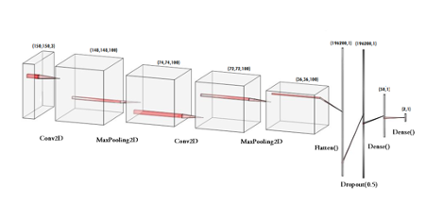
Defining the Model
A sequential model with Keras.
Two Conv2D layers were used to extract important features from input images, 'relu' as an activation function, followed by MaxPooling2D layers, to understand the bigger picture.
A Flatten layer was used to convert the 3D feature maps to 1D feature vectors, and pass input to the fully connected layers.
A Dropout Layer added to help prevent overfitting.
A Dense layer with 'relu' activation function was used to learn non-linear combinations of features and perform the high level reasoning and final decision.
Final Dense layer with 'softmax' as activation function was used for outputting class probabilities.
The model was compiled with the Adam optimizer to adjust weights, binary cross-entropy as the loss function, and accuracy as the evaluation metric.

Slide 12
Data Preparation
Defining Callbacks
The ImageDataGenerator class was used for converting images into batches of preprocessed tensors and for image data augmentation, including rescaling, rotating, shifting, and flipping.
A ModelCheckpoint callback was set to store model weights if validation loss improved during training.
EarlyStopping callback was used to prevent overfitting if validation loss did not improve for three epochs.
ReduceLROnPlateau callback was added to reduce the learning rate if validation loss plateaued.

Slide 13
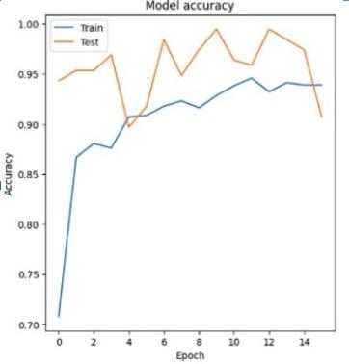
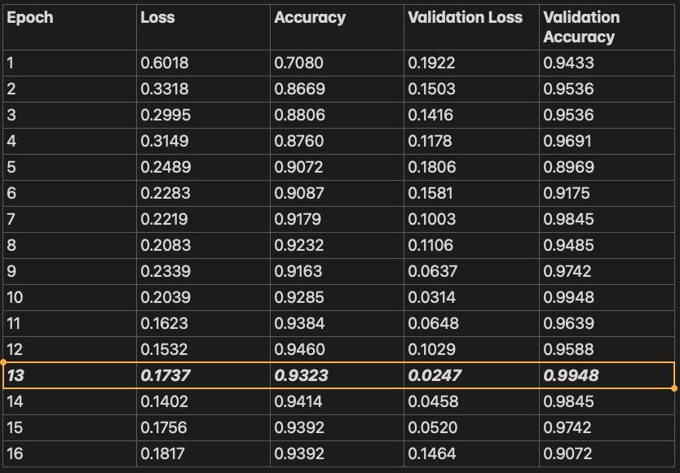
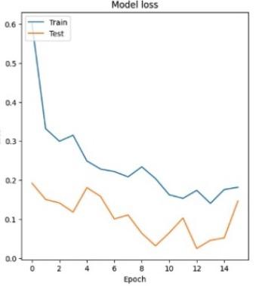
Model Training

Slide 14
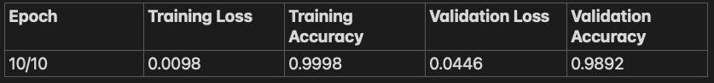
CNN for Face Detection
Prepared dataset of cropped images of faces and open-source images of random objects
Assigned labels based on origin folder (1 for positive, 0 for negative)
Augmented images by shifting, rotating and changing RGB color combinations, generating over 7000 images from around 30 originals
Split data into training (80%) and testing (20%) sets
Reshaped image data to match network input shape, and transformed labels into NumPy arrays
Model followed same architecture with Mask Detection.
Final layer with sigmoid activation function, suitable for binary classification
Compiled model with Adam optimizer, binary cross entropy loss, and accuracy as the evaluation metric

Slide 15

Real-time Mask Detection
The code uses computer vision and our models to detect human faces in a real time/live video stream and determine whether they are wearing masks or not.
The script uses OpenCV for image and video processing and TensorFlow for running trained machine learning models.
Processed the incoming video frames and prepare them for the machine learning models. This includes converting images to grayscale, resizing them, and normalizing the pixel values.
The main method of the class that captures video frames, applies face and mask detection, and visualizes the results on the frames in real-time.

Slide 16
Future Improvements
Rather than employing Haar Cascade, we should further explore the Face Detection Model.
Consider manually annotating about 20 images, utilizing libraries such as LabelMe, labelImg, and RectLabel (despite encountering technical issues).
By using annotation techniques, we can obtain the values of a rectangle that denotes the face, then save both the label and the coordinates - specifically, the top left and bottom right corners.
Once these two coordinates are obtained, we can calculate the width and height of the rectangle.
With this information, we can then use the coordinates alongside the image for the augmentation process.

Slide 17
Thank you for your time 😊

